Slide 1

Advanced NLP (Text Preprocessing)
NLP
Dr. Sajarwo Anggai, S.ST., M.T. NIDN : 0421108703

Slide 2
NLP Pipeline
Text Preprocessing
Feature Extraction
Modeling
Post-Processing
Deployment
Segmentation/ Tokenization
Normalization/ Lowercasing
Stopword Removal
Punctuation Removal
Stemming/ Lemmatization
Depedency parsing
Part-of-Speech Tagging
Bag of Words (BoW)
TF-IDF
Word Embeddings
Machine Learning
Deep Learning
Prediction
Evaluation
Fine-Tuning
Production
Monitoring and Updating

Slide 3
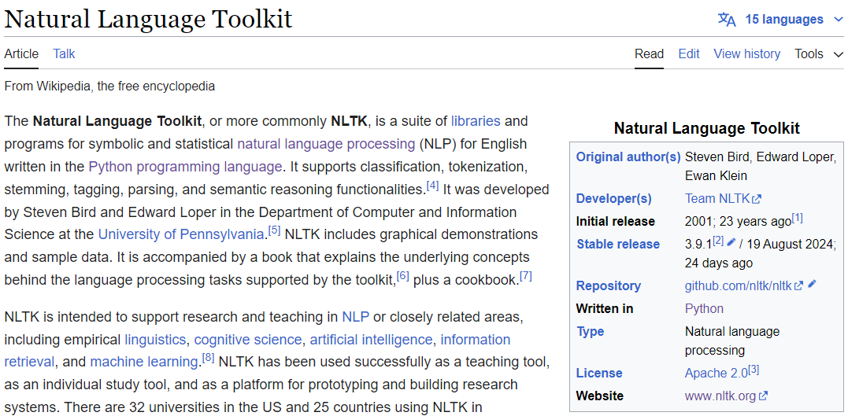
Natural Language Toolkit - NLTK
https://en.wikipedia.org/wiki/Natural_Language_Toolkit

Slide 4
Normalization/ Lowercasing
text = "Natural Language Processing (NLP) is a field of AI that focuses on the interaction between computers ; an'd humans $ through! natural language.“
text = text.lower()
print(text)

Slide 5
Punctuation Removal
text = "Natural Language Processing (NLP) is a field of AI that focuses on the interaction between computers ; an'd humans $ through! natural language."
import string
text = text.translate(text.maketrans("", "", string.punctuation))
print(text)

Slide 6
Segmentation/ Tokenization
from nltk.tokenize import word_tokenize
tokens = word_tokenize(text)
print(tokens)
['natural', 'language', 'processing', 'nlp', 'is', 'a', 'field', 'of', 'ai', 'that', 'focuses', 'on', 'the', 'interaction', 'between', 'computers', 'and', 'humans', 'through', 'natural', 'language']

Slide 7
Stopword Removal
stop_words = set(stopwords.words('english'))
filtered_tokens = [word for word in tokens if word not in stop_words and word.isalnum()]
print(filtered_tokens)
['natural', 'language', 'processing', 'nlp', 'field', 'ai', 'focuses', 'interaction', 'computers', 'humans', 'natural', 'language']

Slide 8
Stemming
from nltk.stem import PorterStemmer
stemmer = PorterStemmer()
words = text.split(",")
stemmed_tokens = [stemmer.stem(word) for word in filtered_tokens]
print(stemmed_tokens)
['natur', 'languag', 'process', 'nlp', 'field', 'ai', 'focus', 'interact', 'comput', 'human', 'natur', 'languag']

Slide 9
Lemmatization
from nltk.stem import WordNetLemmatizer
lemmatizer = WordNetLemmatizer()
lemmatized_tokens = [lemmatizer.lemmatize(word) for word in filtered_tokens]
print(lemmatized_tokens)
['natural', 'language', 'processing', 'nlp', 'field', 'ai', 'focus', 'interaction', 'computer', 'human', 'natural', 'language']

Slide 10
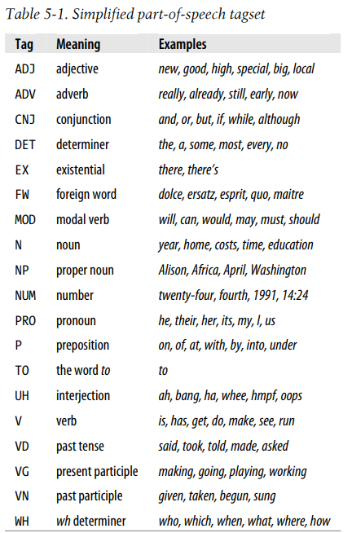
Part-of-Speech Tagging
from nltk import pos_tag
pos_tagged_tokens1 = pos_tag(stemmed_tokens)
pos_tagged_tokens2 = pos_tag(lemmatized_tokens)
print(pos_tagged_tokens1)
print(pos_tagged_tokens2)
[('natur', 'JJ'), ('languag', 'NN'), ('process', 'NN'), ('nlp', 'JJ'), ('field', 'NN'), ('ai', 'NN'), ('focus', 'NN'), ('interact', 'NN'), ('comput', 'NN'), ('human', 'JJ'), ('natur', 'NN'), ('languag', 'NN’)]
[('natural', 'JJ'), ('language', 'NN'), ('processing', 'NN'), ('nlp', 'JJ'), ('field', 'NN'), ('ai', 'NN'), ('focus', 'NN'), ('interaction', 'NN'), ('computer', 'NN'), ('human', 'JJ'), ('natural', 'JJ'), ('language', 'NN')]
S. Bird et al. NLP with Python – Oreilly.

Slide 11
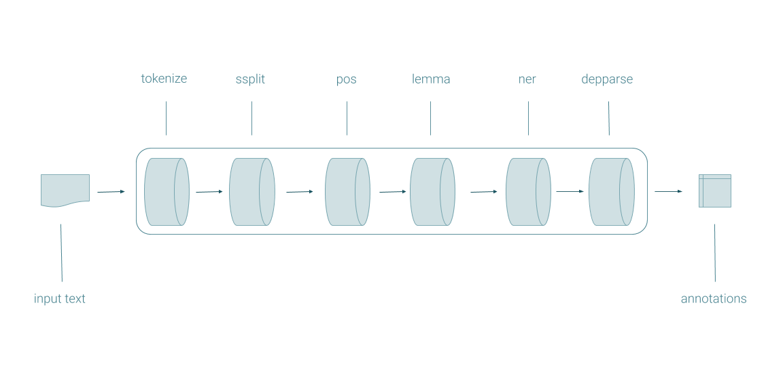
Stanford CoreNLP
CoreNLP is your one stop shop for natural language processing in Java! CoreNLP enables users to derive linguistic annotations for text, including token and sentence boundaries, parts of speech, named entities, numeric and time values, dependency and constituency parses, coreference, sentiment, quote attributions, and relations. CoreNLP currently supports 8 languages: Arabic, Chinese, English, French, German, Hungarian, Italian, and Spanish.
https://stanfordnlp.github.io/CoreNLP/index.html

Slide 12
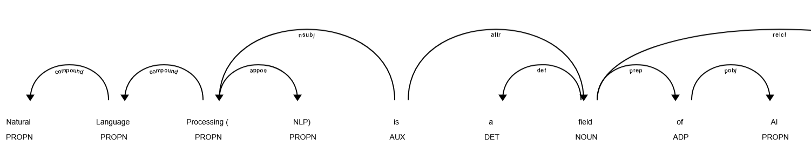
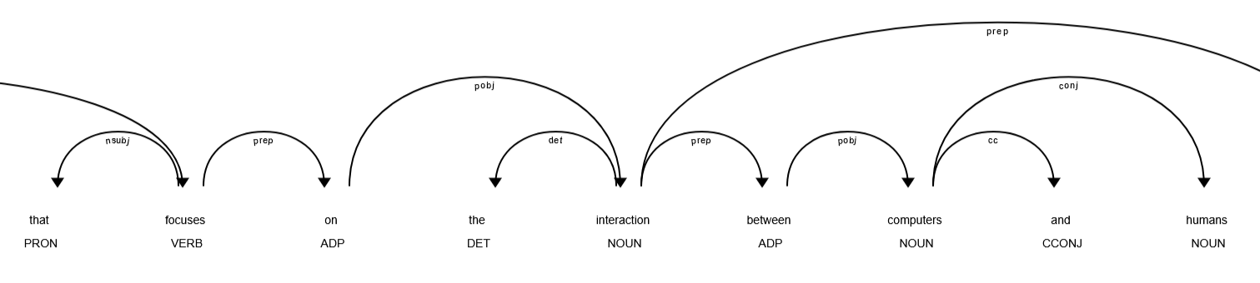
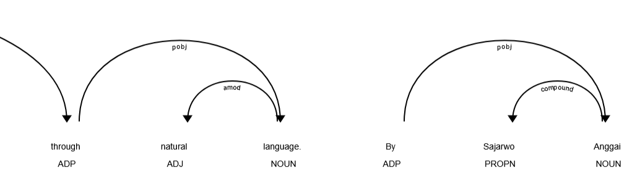
Depedency Parsing
Natural Language Processing (NLP) is a field of AI that focuses on the interaction between computers and humans through natural language. By Sajarwo Anggai

Slide 13
Depedency Parsing (1)
!wget https://nlp.stanford.edu/software/stanford-corenlp-4.5.4.zip
!unzip stanford-corenlp-4.5.4.zip

Slide 14
Depedency Parsing (2)
from nltk.parse.stanford import StanfordDependencyParser
path_to_jar = '/content/stanford-corenlp-4.5.4/stanford-corenlp-4.5.4.jar'
path_to_models_jar = '/content/stanford-corenlp-4.5.4/stanford-corenlp-4.5.4-models.jar'
dependency_parser = StanfordDependencyParser(path_to_jar=path_to_jar, path_to_models_jar=path_to_models_jar)
result = dependency_parser.raw_parse(" ".join(lemmatized_tokens))
dep_data = next(result)
print ("{:<15} | {:<10} | {:<10} | {:<15} | {:<10}".format('Head', 'Head POS','Relation','Dependent', 'Dependent POS'))
print ("-" * 75)
for dep in list(dep_data.triples()):
print ("{:<15} | {:<10} | {:<10} | {:<15} | {:<10}"
.format(str(dep[0][0]),str(dep[0][1]), str(dep[1]), str(dep[2][0]),str(dep[2][1])))

Slide 15
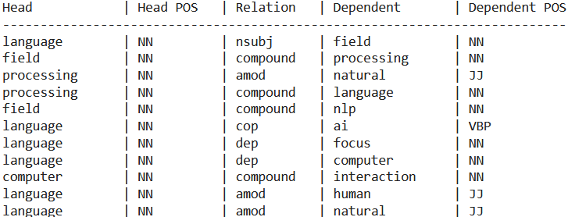
Depedency Parsing (3)

Slide 16
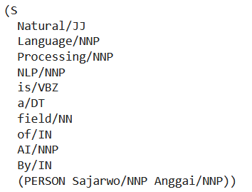
NER
text = "Natural Language Processing (NLP) is a field of AI. By Sajarwo Anggai"
text = text.translate(text.maketrans("", "", string.punctuation))
tokens = word_tokenize(text)
tagged_tokens = nltk.pos_tag(tokens)
ner_tree = ne_chunk(tagged_tokens)
print(ner_tree)

Slide 17
preprocess_text function
def preprocess_text(text):
text = text.lower()
text = text.translate(text.maketrans("", "", string.punctuation))
tokens = word_tokenize(text)
stop_words = set(stopwords.words('english'))
filtered_tokens = [word for word in tokens if word not in stop_words and word.isalnum()]
ps = PorterStemmer()
stemmed_tokens = [ps.stem(word) for word in filtered_tokens]
lemmatizer = WordNetLemmatizer()
lemmatized_tokens = [lemmatizer.lemmatize(word) for word in filtered_tokens]
pos_tagged_tokens1 = pos_tag(stemmed_tokens)
pos_tagged_tokens2 = pos_tag(lemmatized_tokens)
return {
"original_text": text,
"tokens": tokens,
"filtered_tokens": filtered_tokens,
"stemmed_tokens": stemmed_tokens,
"lemmatized_tokens": lemmatized_tokens,
"pos_tagged_tokens1": pos_tagged_tokens1,
"pos_tagged_tokens2": pos_tagged_tokens2,
}

Slide 18
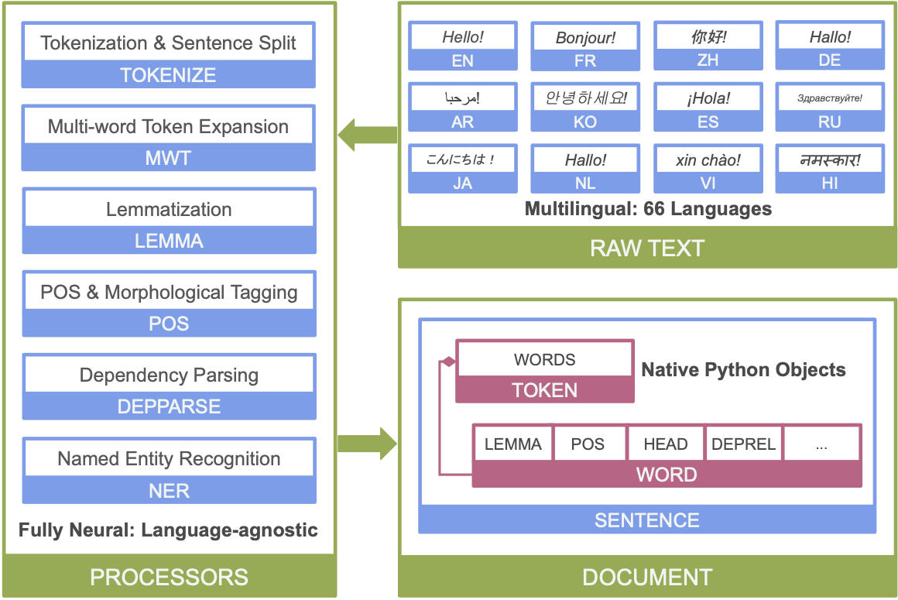
Stanza
Stanza is a collection of accurate and efficient tools for the linguistic analysis of many human languages. Starting from raw text, Stanza divides it into sentences and words, and then can recognize parts of speech and entities, do syntactic analysis, and more. Stanza brings state-of-the-art NLP models to languages of your choosing.
https://stanfordnlp.github.io/stanza/

Slide 19
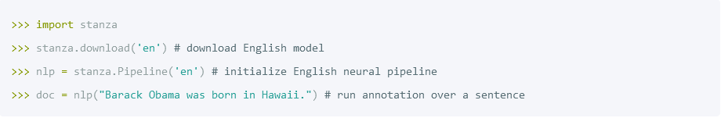
Stanza
Native Python implementation requiring minimal efforts to set up;
Full neural network pipeline for robust text analytics, including tokenization, multi-word token (MWT) expansion, lemmatization, part-of-speech (POS) and morphological features tagging, dependency parsing, and named entity recognition;
Pretrained neural models supporting 70 (human) languages;
A stable, officially maintained Python interface to CoreNLP.
https://stanfordnlp.github.io/stanza/

Slide 20
Install stanza (1)
import nltk
from nltk.tokenize import word_tokenize
from nltk.corpus import stopwords
from nltk.stem import PorterStemmer, WordNetLemmatizer
from nltk import pos_tag, ne_chunk, RegexpParser
import string
from nltk.stem import PorterStemmer
from nltk.stem import WordNetLemmatizer
from nltk import pos_tag
from nltk.parse.stanford import StanfordDependencyParser
nltk.download('punkt')
nltk.download('stopwords')
nltk.download('wordnet')
nltk.download('averaged_perceptron_tagger')
nltk.download('maxent_ne_chunker')
nltk.download('words')
!pip install stanza import stanza
# Download the English model
stanza.download('en')

Slide 21
Install stanza (2)
nlp = stanza.Pipeline('en')
def preprocess_text_stanfordnlp(text):
doc = nlp(text)
tokens = [word.text for sent in doc.sentences for word in sent.words]
lemmas = [word.lemma for sent in doc.sentences for word in sent.words]
pos_tags = [word.upos for sent in doc.sentences for word in sent.words]
dependencies = []
for sent in doc.sentences:
for word in sent.words:
dependencies.append((word.head, word.deprel, word.id))
ner_tags = []
for ent in doc.ents:
ner_tags.append((ent.text, ent.type))
return {
"original_text": text,
"tokens": tokens,
"lemmas": lemmas,
"pos_tags": pos_tags,
"dependencies": dependencies,
"ner_tags": ner_tags,
}
text = "Natural Language Processing (NLP) is a field of AI that focuses on the interaction between computers and humans through natural language. By Sajarwo Anggai"
result = preprocess_text_stanfordnlp(text)
for step, output in result.items():
print(f"{step.capitalize().replace('_', ' ')}:\n{output}\n")

Slide 22
Stanza output
Original text:
Natural Language Processing (NLP) is a field of AI that focuses on the interaction between computers and humans through natural language. By Sajarwo Anggai
Tokens:
['Natural', 'Language', 'Processing', '(', 'NLP', ')', 'is', 'a', 'field', 'of', 'AI', 'that', 'focuses', 'on', 'the', 'interaction', 'between', 'computers', 'and', 'humans', 'through', 'natural', 'language', '.', 'By', 'Sajarwo', 'Anggai']
Lemmas:
['Natural', 'Language', 'processing', '(', 'NLP', ')', 'be', 'a', 'field', 'of', 'AI', 'that', 'focus', 'on', 'the', 'interaction', 'between', 'computer', 'and', 'human', 'through', 'natural', 'language', '.', 'by', 'Sajarwo', 'Anggai']
Pos tags:
['ADJ', 'PROPN', 'PROPN', 'PUNCT', 'PROPN', 'PUNCT', 'AUX', 'DET', 'NOUN', 'ADP', 'NOUN', 'PRON', 'VERB', 'ADP', 'DET', 'NOUN', 'ADP', 'NOUN', 'CCONJ', 'NOUN', 'ADP', 'ADJ', 'NOUN', 'PUNCT', 'ADP', 'PROPN', 'PROPN']
Dependencies:
[(2, 'amod', 1), (3, 'compound', 2), (9, 'nsubj', 3), (5, 'punct', 4), (3, 'appos', 5), (5, 'punct', 6), (9, 'cop', 7), (9, 'det', 8), (0, 'root', 9), (11, 'case', 10), (9, 'nmod', 11), (13, 'nsubj', 12), (11, 'acl:relcl', 13), (16, 'case', 14), (16, 'det', 15), (13, 'obl', 16), (18, 'case', 17), (16, 'nmod', 18), (20, 'cc', 19), (18, 'conj', 20), (23, 'case', 21), (23, 'amod', 22), (16, 'nmod', 23), (9, 'punct', 24), (2, 'case', 1), (0, 'root', 2), (2, 'flat', 3)]
Ner tags:
[('Natural Language Processing', 'ORG'), ('NLP', 'ORG'), ('Sajarwo Anggai', 'PERSON')]

Slide 23
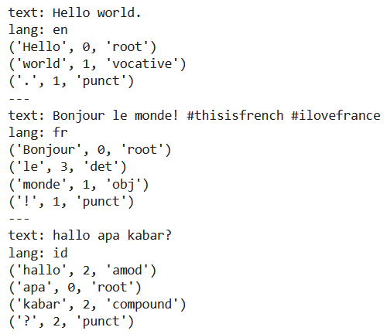
Stanza MultilingualPipeline
from stanza.pipeline.multilingual import MultilingualPipeline
lang_id_config = {"langid_clean_text": True}
lang_configs = {"en": {"processors": {"ner": "conll03"}}}
nlp = MultilingualPipeline(lang_id_config=lang_id_config, lang_configs=lang_configs)
docs = ["Hello world.", "Bonjour le monde! #thisisfrench #ilovefrance", "hallo apa kabar?"]
docs = nlp(docs)
for doc in docs:
print("---")
print(f"text: {doc.text}")
print(f"lang: {doc.lang}")
print(f"{doc.sentences[0].dependencies_string()}")

Slide 24
Tugas
Cari 10 jurnal terkait dengan perkembangan Preprocessing di NLP
Buatlah program untuk melakukan Text Preprocessing pada suatu dokumen

Slide 25

Universitas Pamulang
Prodi Teknik Informatika S-2
Sajarwo Anggai
Dosen – Universitas Pamulang
NIDN : 0421108703
Email : dosen02832@unpam.ac.id
Terima Kasih

